Slide 1
How to use GitHub
Shawn 04/28/2016

Slide 2
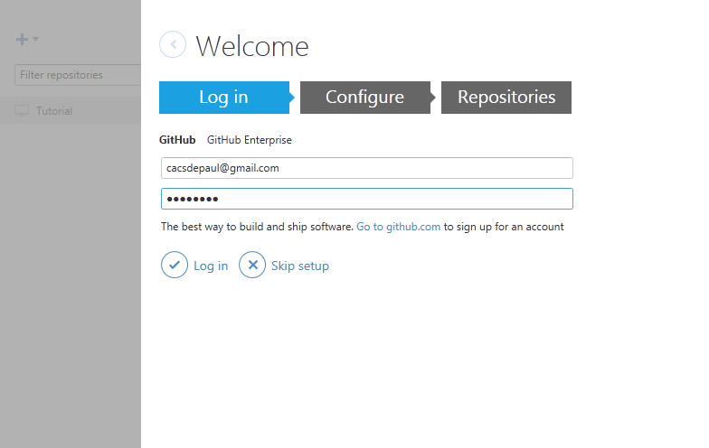
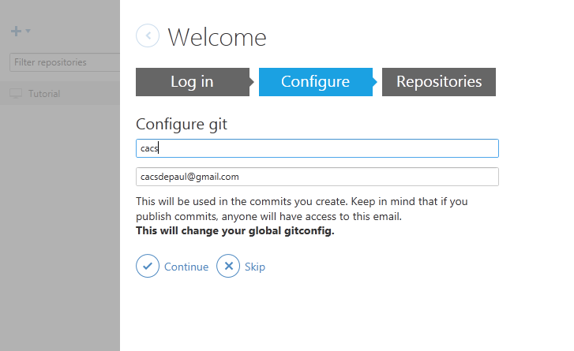
1. Go to https://github.com/,create a new account.
2. If you use Windows, go to https://desktop.github.com/, download GitHub Desktop (the client), install it.
3. If you use Linux, refer to this doc https://git-scm.com/download/linux
4. Create a directory as the root of repository. i.e. C:\Users\Shawn\GitHub
5. Open GitHub, the GUI Client. Login with the username password in step 1.

Slide 3
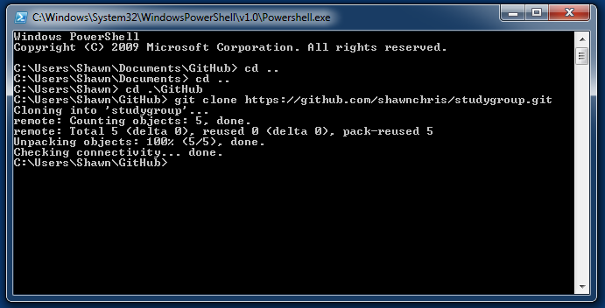
6. Run Git Shell and Clone the public repository to local directory created in step 4.
C:\Users\Shawn\Documents\GitHub> cd ..\..\
C:\Users\Shawn> cd .\GitHub
C:\Users\Shawn\GitHub> git clone https://github.com/shawnchris/studygroup.git
Cloning into 'studygroup'...
remote: Counting objects: 5, done.
remote: Total 5 (delta 0), reused 0 (delta 0), pack-reused 5
Unpacking objects: 100% (5/5), done.
Checking connectivity... done.

Slide 4
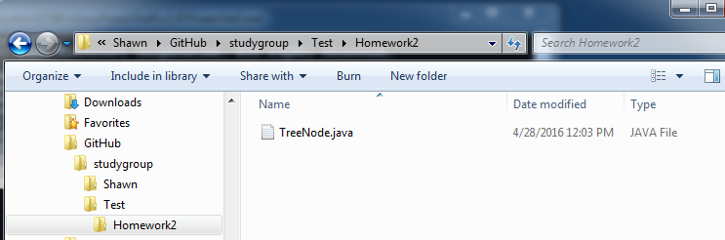
7. Create your own directory inside local repository, i.e. C:\Users\Shawn\GitHub\Test (better be your name)
8. Copy files you want to check in to this directory

Slide 5
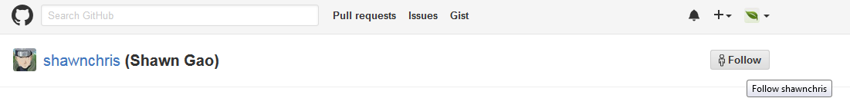
10. Open browser and go to https://github.com/shawnchris and follow me!
Then I know what’s your Git Hub ID and will give you write access to the repository.

Slide 6
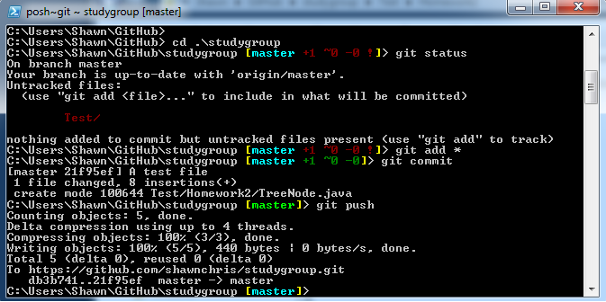
11. After I give you access, go back to Git Shell and commit your changes.
C:\Users\Shawn\GitHub> cd .\studygroup
C:\Users\Shawn\GitHub\studygroup [master +1 ~0 -0 !]> git status
C:\Users\Shawn\GitHub\studygroup [master +1 ~0 -0 !]> git add *
C:\Users\Shawn\GitHub\studygroup [master +1 ~0 -0]> git commit
C:\Users\Shawn\GitHub\studygroup [master]> git push

